Slide 1


IoT Security: Problems, Challenges and Solutions
Dr. Gaurav Bansod
Department of Electronics and Telecommunications
Pune Institute of Computer Technology, Pune,
Maharashtra, India.

Slide 2
What is Cryptography ?
Encryption Process :
Transforming data
Using the algorithm
To make it unreadable to anyone
Except those possessing the key
Kerckhoff’s Principle : (1883)
A cryptosystem should be secure even if the attackers knows all the details about the system with exception of the secret key.

Slide 3
What is Encryption System?
Hacker
Y
Y
Insecure Channel
Y
X
X
E
D
K
K
Secure Channel

Slide 4

Lightweight Cryptography ?
It endorses algorithms which are best suited for constrained environment
For e.g. RFID Tags, sensors, contactless smart card, health-care devices and so on.
GE’S should be less than 2200.
Lightweight Cryptography
Heavy Security Algorithm

Slide 5
Parameters in Lightweight Cryptography
Constrains
GE’s
Memory Requirement
Power Consumption
Throughput
Security

Slide 6
Classification
Security
Cryptology
Cryptography Cryptanalysis
Symmetric Key Asymmetric Key
Block Cipher Stream Cipher

Slide 7
Stream Cipher Vs Block Cipher
Stream Cipher
Pseudo Random bits are used for encryption and decryption
Practical Issue: Can generate the pseudorandom bits offline and decrypt very quickly without buffering.
E.g. Linear Feedback Shift Register (LFSR) but not secure.
Block Cipher:
Main goal of these ciphers are Security.
Permutation can be happened in Block cipher.
Permutation can be possible in Block Cipher which gives more diffusion layer.
E.g. AES, DES, PRESENT, FeW, etc.

Slide 8
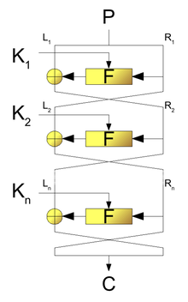
Block Ciphers
The Block Ciphers are further classified into three types i.e. Feistel Structure , SP Network and Generalized Feistel Structure.
Feistel Structure

Slide 9
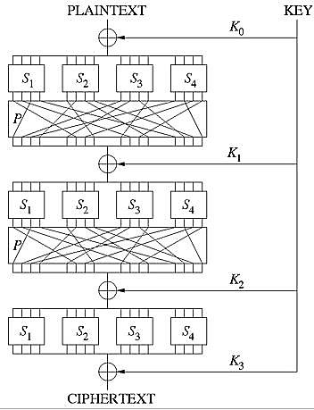
SP Network

Slide 10
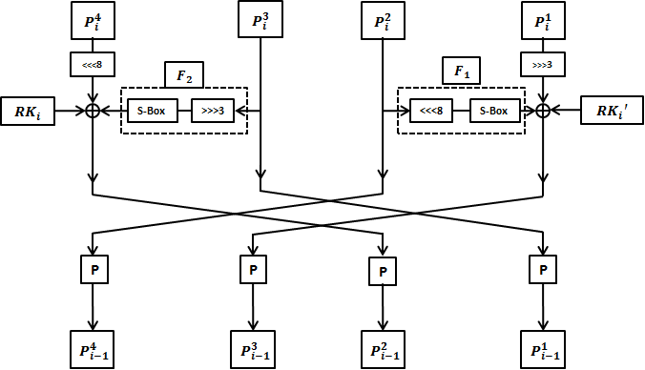
Generalized Feistel Structure

Slide 11
Existing Block Ciphers
Table gives the some important parameter comparison for existing block ciphers.
Algorithms | Block Size | Key Size | Structure | GE's | Memory (Bytes) | Power (mW)
PRESENT | 64 | 128 | SPN | 1339 | 2756 | 38
SIMON | 64 | 128 | Feistel | 954 | 2324 | 35
SPECK | 64 | 128 | Feistel | 996 | 2310 | 31
LED | 64 | 128 | SPN | 1265 | 3876 | 100
Rectangle | 64 | 128 | SPN | 1787 | 2372 | 31
CLEFIA | 64 | 128 | GFN | 2488 | 4708

Slide 12
Main Blocks In Cipher Designs
There are some blocks which are required to design the Ciphers. E.g. S – Box, X – Or, Block Permutation, Bit permutation and Shifting.
1) S – Box
X | 0 | 1 | 2 | 3 | 4 | 5 | 6 | 7 | 8 | 9 | A | B | C | D | E | F
S(x) | 3 | F | E | 1 | 0 | A | 5 | 8 | C | 4 | B | 2 | 9 | 7 | 6 | D
Binary 0 0 0 0
0 hex
4 bit S-Box
Binary 0 0 1 1
3 hex

Slide 13
2) Bit Permutation
X | 0 | 1 | 2 | 3
P(X) | 2 | 3 | 0 | 1
Binary 1 1 1 0
e hex
4 bit P-layer
Binary 1 0 1 1
3 hex

Slide 14
3) Block Permutation
12345678 hex
1 2 3 4 5 6 7 8
3 4 1 2 7 8 5 6
34127856 hex

Slide 15
4) Circular Shifting (Left shift by 2)
F |  |  |  | 2
7 | 6 | 5 | 4 | 3 | 2 | 1 | 0
1 | 1 | 1 | 1 | 0 | 0 | 1 | 0
E |  |  |  | 5
7 | 6 | 5 | 4 | 3 | 2 | 1 | 0
1 | 1 | 1 | 0 | 0 | 1 | 0 | 1
C |  |  |  | B
7 | 6 | 5 | 4 | 3 | 2 | 1 | 0
1 | 1 | 0 | 0 | 1 | 0 | 1 | 1

Slide 16
5) X - OR
1 0 1 0
0 1 0 1
1 1 1 1
Why Only X – OR is used in design why not AND, OR …… ?
1 | 0 | 1 | 0 | Plain Text
0 | 1 | 0 | 1 | Key
1 | 1 | 1 | 1 | Cipher Tex
Encryption
1 | 1 | 1 | 1 | Cipher Text
0 | 1 | 0 | 1 | Key
1 | 0 | 1 | 0 | Plain Text
Decryption

Slide 17
AND Gate and OR Gate Explanation
1 | 0 | 1 | 0 | Plain Text
0 | 1 | 0 | 1 | Key
0 | 0 | 0 | 0 | Cipher Tex
AND
Encryption
0 | 0 | 0 | 0 | Cipher Text
0 | 1 | 0 | 1 | Key
0 | 1 | 0 | 1 | Plain Text
AND
Decryption
1 | 0 | 1 | 0 | Plain Text
0 | 1 | 0 | 1 | Key
1 | 1 | 1 | 1 | Cipher Tex
OR
Encryption
1 | 1 | 1 | 1 | Cipher Text
0 | 1 | 0 | 1 | Key
1 | 1 | 1 | 1 | Plain Text
OR
Decryption

Slide 18
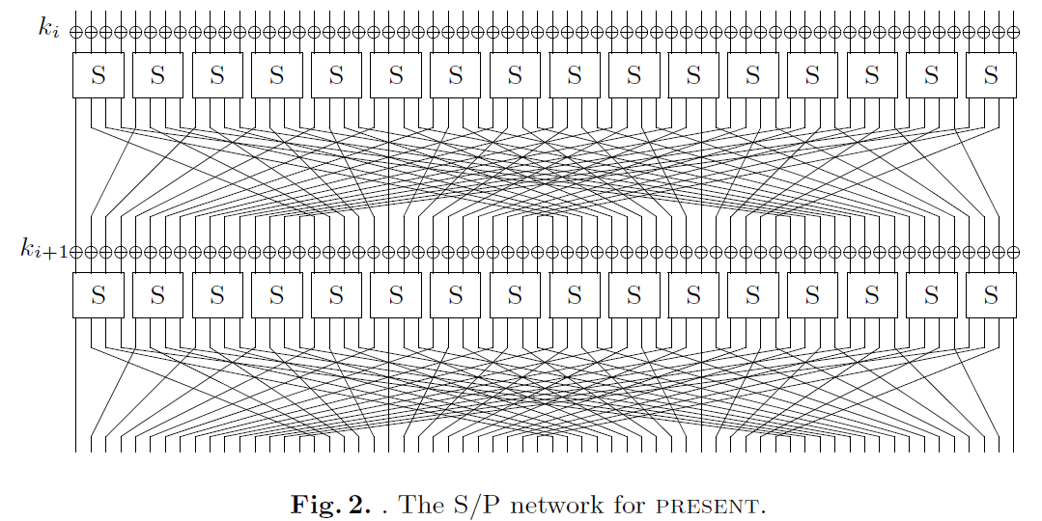
Existing Cipher Designs Till date
1) PRESENT (An ISO Certified Cipher)
PRESETN is an ISO certified SP Network

Slide 19
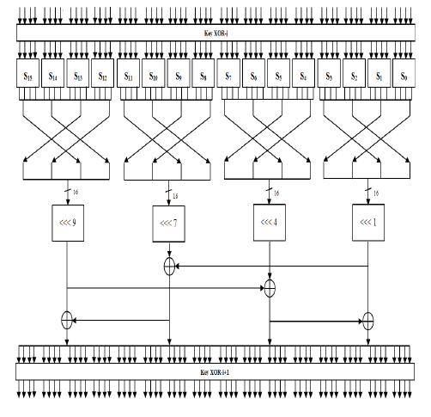
2) BORON (SP Network)

Slide 20
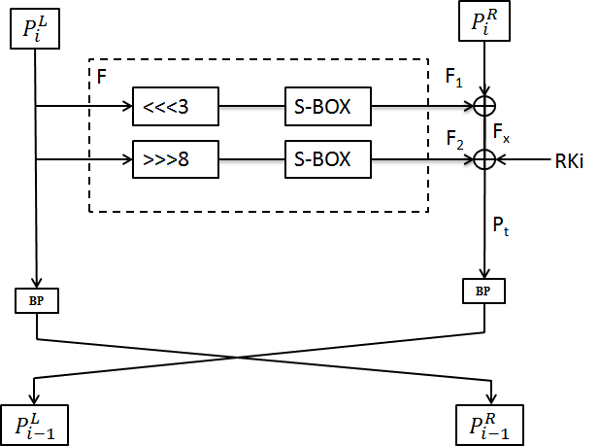
3) ANU (Feistel Structure)

Slide 21
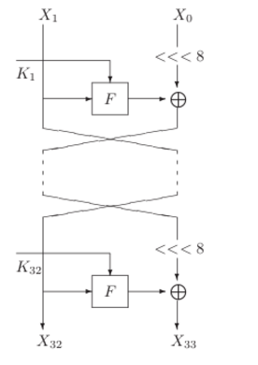
4) LBlock (Feistel Structure)

Slide 22
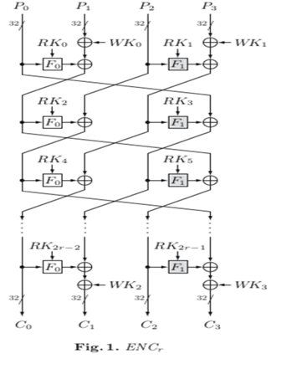
5) CLEFIA (Generalized Feistel Structure)

Slide 23
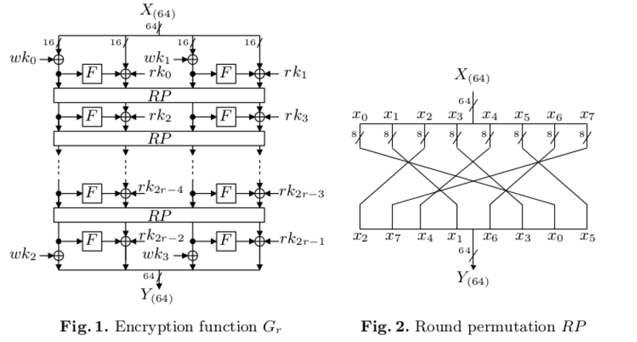
6) PICCOLO (Generalized Feistel Structure)

Slide 24
Merits and Demerits of SP, Feistel and GFS
SP Network
SP Network has very strong in terms of security
It uses 64 bit of permutation so throughput is less
It requires more GE’s
Feistel Structure
Due to the use of block shuffling it has high throughput
Requires les number of GE’s as compared to other networks
Gives best security
Due to data divide uses less memory
Generalized Feistel Structure
It has more throughput
It has less memory requirement
Due to number of blocks the key scheduling is also divided
Might be gives low security assurance.

Slide 25
Input and Key
64 Bit Plain Text
P₆₃ P₁ P₀
……………………………
K₁₂₇ …………… K₁ K₀
X - OR
Rotate Same Round
128 Bit Key
From that take only 64 bit key as per key scheduling algorithm
……………………………
Design Box
……………………………
C₆₃ C₁ C₀
64 Bit Cipher Text

Slide 26
How Key is Generated?
128 Bit Plain Text
K₁₂₈ K₁ K₀
……………………………
Rotate Same Round
Key Scheduling Algorithm
……………………………
K₁₂₈ K₁ K₀
After applying key scheduling algorithm we can use 64 bit, 32 bit or 16 bit key from 128 bit key which is based on your design.

Slide 27
Key Scheduling Algorithm
128 Bit Key
K₁₂₈ K₁ K₀
……………………………
Rotate Same Round
left circular shift by 13
……………………………
Apply S – box on left most 8 bit
……………………………
Add Round Counter
Extract 128 bit, 64 bit, 32 bit or 16 bit Key as per your design
……………………………
K₁₂₈ K₁ K₀

Slide 28
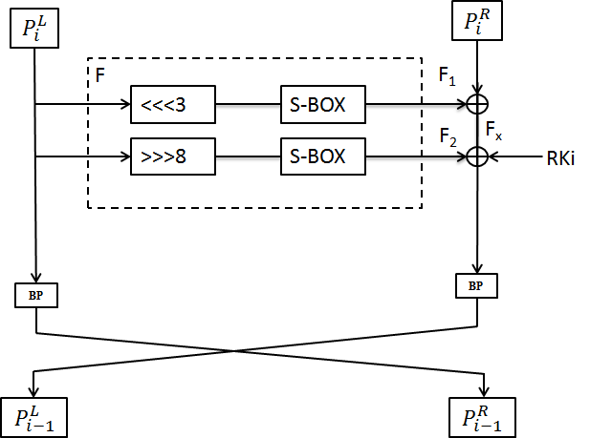
Structure

Slide 29
How to make Design Lightweight ?
Memory Aspect:
Reduce the number of the variable in code
Use maximum local variables
Use the functions which help to reduce the code size
Power Aspect:
Power is controlled by use of minimum rounds but security should not be compromised
GE’s
Use minimum number of S – Boxes because it requires GE’s
Use minimum number of X – OR operations
Use more number of permutations because permutation doesn’t require GE’s but with increasing in permutation throughput gets increased

Slide 30
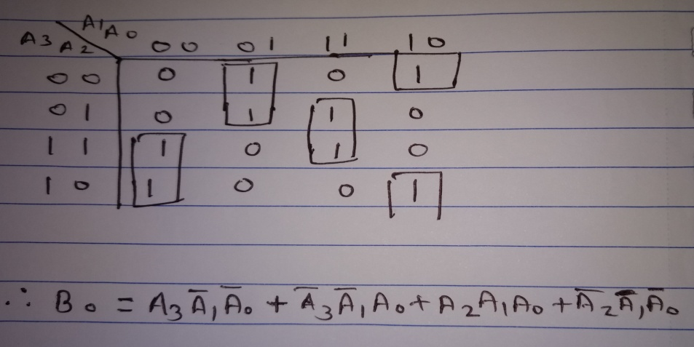
Blocks which require GE’s
Mainly the GE’s are required for the S – Box, Storing Element and X – Or.
1) S - Box
K – Map
A₃ | A₂ | A₁ | A₀ | B₃ | B₂ | B₁ | B₀
0 | 0 | 0 | 0 | 0 | 0 | 1 | 1
0 | 0 | 0 | 1 | 1 | 1 | 1 | 1
0 | 0 | 1 | 0 | 1 | 1 | 1 | 0
0 | 0 | 1 | 1 | 0 | 0 | 0 | 1
0 | 1 | 0 | 0 | 0 | 0 | 0 | 0
0 | 1 | 0 | 1 | 1 | 0 | 1 | 0
0 | 1 | 1 | 0 | 0 | 1 | 0 | 1
0 | 1 | 1 | 1 | 1 | 0 | 0 | 0
1 | 0 | 0 | 0 | 1 | 1 | 0 | 0
1 | 0 | 0 | 1 | 0 | 1 | 0 | 0
1 | 0 | 1 | 0 | 1 | 0 | 1 | 1
1 | 0 | 1 | 1 | 0 | 0 | 1 | 0
1 | 1 | 0 | 0 | 1 | 0 | 0 | 1
1 | 1 | 0 | 1 | 0 | 1 | 1 | 1
1 | 1 | 1 | 0 | 0 | 1 | 1 | 0
1 | 1 | 1 | 1 | 1 | 1 | 0 | 1
Can Calculate other equitation's also by using the K – Map
AND, OR and NOT require physical memory to store the bits.
One 4 bit S – Box requires 28 GEs

Slide 31
2) X - OR
X – Or requires data register to store the bit so it requires 2 GE’s
3) Bit Permutation, Block Permutation and Shifting
Bit permutation, Block permutation and circular shifting doesn’t requires GE’s. It requires only wires so use of permutation and shifting will save the GE.
ASIC Technology Table
For calculation of GE we used standard library of IBM 8RF with 0.13um technology.
Gates | No. of GE’s
NOT | 0.75
AND | 1.25
OR | 1.25
XOR | 2.00
2:1 MUX | 2.25
D flip flop | 4.25

Slide 32

64 Bit data register = 64*4.25 = 272 GE
Approximately for 4 bit S – Box 28GE are required = 28*8 = 224
For X – Or 2 GE’s are required = 32*2 =64
No GE Required
Complete Key scheduling algorithm requires 500GE’s
For X – Or 2 GE’s are required = 32*2 =64
Approximately for 4 bit S – Box 28GE are required = 28*8 = 224
No GE Required

Slide 33
Main Objective
Constrains
GE’s
Memory Requirement
Power Consumption
Throughput
Security

Slide 34
Why we used 64 bit plain Text and 128 bit Key ?
1) Brute Force Attack
By taking A to Z letters with each combinations :
26 * 25 * 24 * ……..*1 = 26 ! = 2 ^ 88 = 2 ^ 56 * 2^ 32
A cubana Machine can find the data of 2^56 in one day so for other 2^32 data it requires some years nearly equal to 99 years.
So we used large key space i.e. 128 bit key.

